Slide 1
Digital Portfolio
STUDENT NAME:Nithish V
REGISTER NO AND NMID: astvu20324u09060
DEPARTMENT: BCA
COLLEGE:Dr. M.G. R. CHOCKALINGAM ARTS COLLEGE/THIRUVALLU UNIVERSITY

Slide 2
PROJECT TITLE
Student digital portfolio using front end development

Slide 3


AGENDA
Problem Statement
Project Overview
End Users
Tools and Technologies
Portfolio design and Layout
Features and Functionality
Results and Screenshots
Conclusion
Github Link
3/21/2024 Annual Review

Slide 4

PROBLEM STATEMENT
Creating a personal portfolio website is essential in today's digital age, as it allows individuals to showcase their skills, experience, and projects to potential employers, clients, or collaborators.
A well-designed portfolio website can make a significant difference in establishing a strong online presence.

Slide 5

PROJECT OVERVIEW
The portfolio website project aims to create a visually appealing and user-friendly platform that effectively showcases skills, experience, and projects.
The website will be designed and developed using HTML, CSS, and JavaScript, with a focus on responsiveness and smooth navigation.

Slide 6

WHO ARE THE END USERS?
The target audience for this portfolio website includes potential employers, clients, collaborators, and industry peers who are interested in learning more about skills, experience, and projects.
Understanding the needs and preferences of the target audience is crucial in designing a website that meets their expectations.

Slide 7

TOOLS AND TECHNIQUES
The choice of tools and technologies used in building the portfolio website is critical to its success.
HTML, CSS, and JavaScript will be used to create a robust and interactive website, while front-end frameworks and responsive design techniques will ensure a seamless user experience.

Slide 8
POTFOLIO DESIGN AND LAYOUT
A well-designed portfolio website requires a thoughtful approach to layout and design.
The website will feature a clean and modern design, with clear navigation and sections that showcase skills, experience, and projects.
8

Slide 9
FEATURES AND FUNCTIONALITY
The portfolio website will include a range of features and functionality, such as smooth scrolling, interactive elements, and project showcases.
These features will enhance the user experience and provide a engaging way to explore the website.

Slide 10
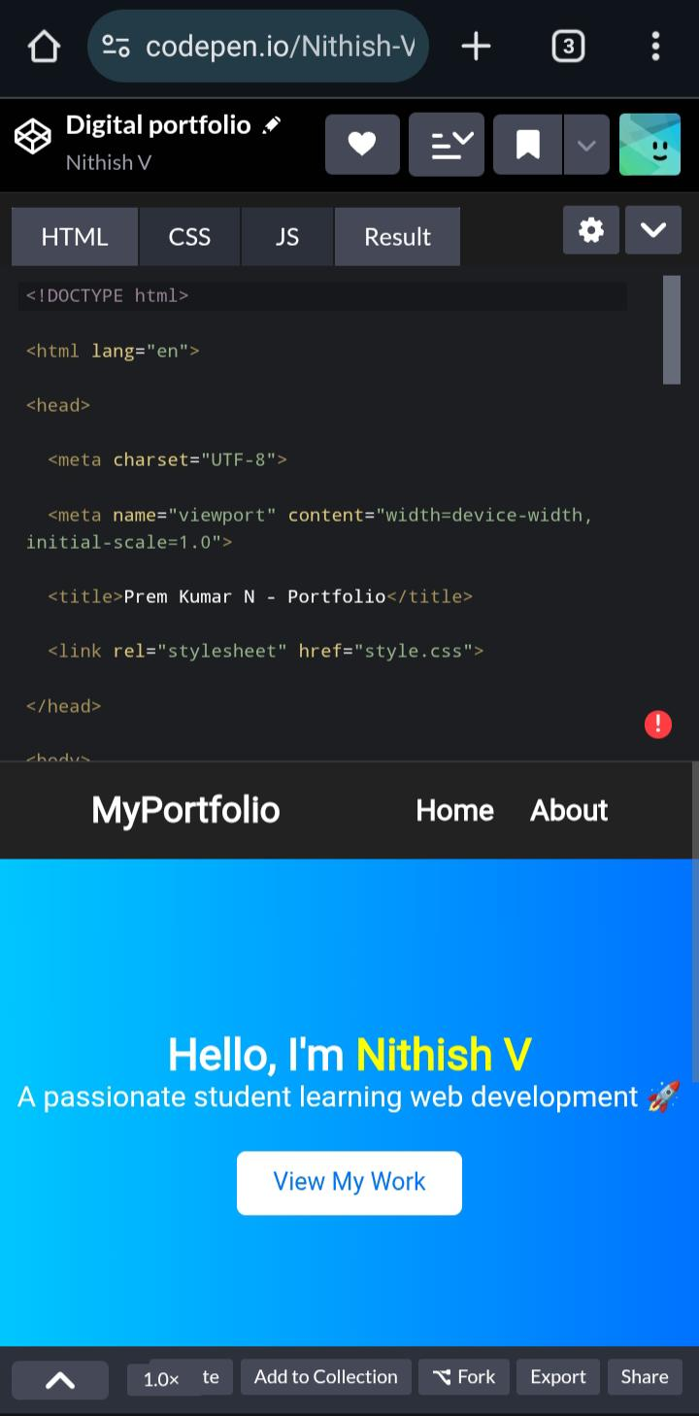
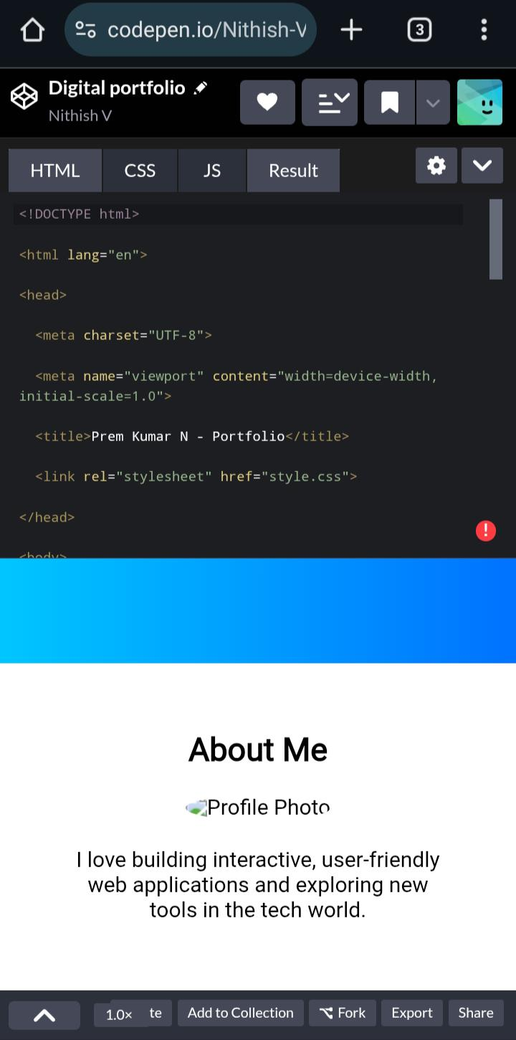

RESULTS AND SCREENSHOTS
3/21/2024 Annual Review
10

Slide 11
CONCLUSION
In conclusion, the portfolio website project demonstrates the importance of having a strong online presence in today's digital age.
The website will provide a platform for showcasing skills, experience, and projects, while establishing a professional brand.
11

Slide 12
Github Link
https://nithish20324u09060-ship-it.github.io/Digital-portfolio-/

